Slide 1
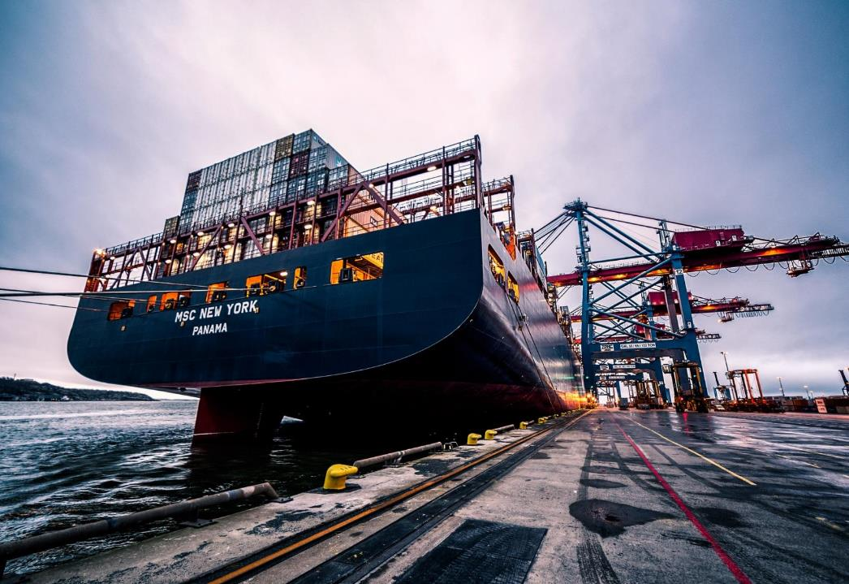
Adventure Works
Analysis and recommendations for Supply Chain Optimization in Year 2014
Notes:
Links:
https://www.pexels.com/photo/black-sail-ship-on-body-of-water-906982/

Slide 2
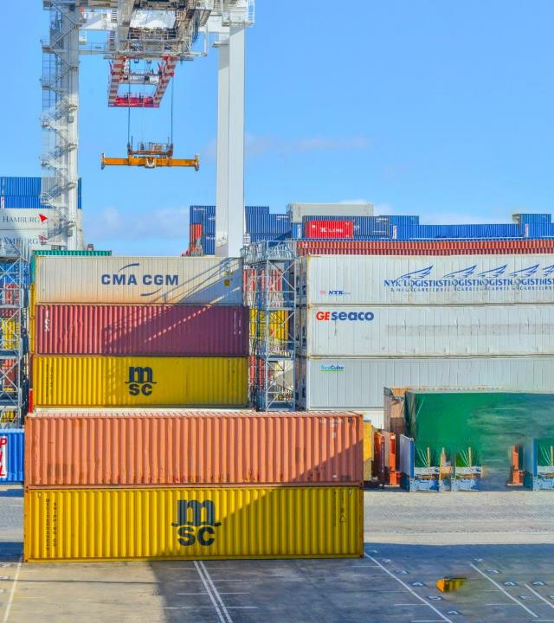

Business Goal
Reducing the delivery time and the procurement costs through inventory and procurement process optimization.
Notes:
Links:
https://www.pexels.com/photo/assorted-color-trailer-boxes-2881632/

Slide 3



Background
Background: Adventure Works Cycles is characterized as a multinational manufacturer and seller of metal and composite bicycles for commercial markets in North America, Europe, and Asia.
The operational hub is located in Bothell, Washington, housing 290 employees, alongside regional sales teams. In 2000, Adventure Works Cycles acquired a small manufacturing facility, Importadores Neptuno, located in Mexico.
Importadores Neptuno produces several subcomponents for the Adventure Works Cycles product line. These subcomponents are then shipped to the Bothell location for final product assembly.
By 2001, Importadores Neptuno had become the sole producer and distributor of the touring bicycle product group. Following a successful fiscal year, Adventure Works Cycles aims to expand its market share by targeting top-tier clients, increasing product availability through an external website, and reducing sales costs via lower production expenses.
StoreLink:
clearresolutiondesign.com
https://adventure-workscycles.com/shop
Source:
https://a.rbind.io/post/intro/
https://flylib.com/books/en/4.65.1.23/1/

Slide 4
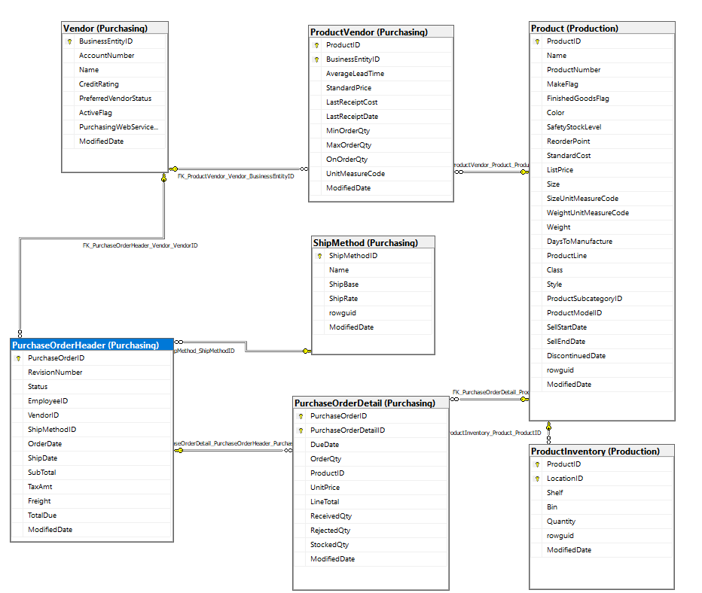
Documentation
Internal: We are going to use data from the following tables :
Purchasing.PurchaseOrderHeader, Purchasing.Vendor, Purchasing.ShipMethod, Purchasing.ProductVendor, Production.Product, Production.ProductInventory
External: We are going to use data from the Adventure Works Dictionary (file:///C:/Users/Test/Desktop/AdventureWorks.pdf)
Cyclic: fnGetProductInventory Function - This function provides the current stock for a specific product.
Notes:
Links:
https://www.pexels.com/photo/men-s-wearing-black-suit-jacket-and-pants-937481/
https://www.pexels.com/photo/business-businessman-contemporary-corporate-532220/
https://www.pexels.com/photo/happy-ethnic-woman-sitting-at-table-with-laptop-3769021/
https://www.pexels.com/photo/cheerful-woman-smiling-while-sitting-at-table-with-laptop-4467687/

Slide 5
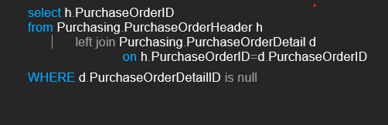
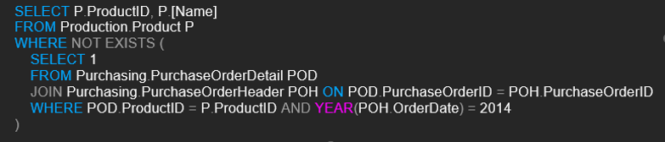
Test the basic variables
I. Example of continuous Variables:
OrderQty/Quantity,OrderDate, LineTotal,StandardCost,StandardPrice, ListPrice
II.Example of categorical Variables:
VendorName, ProductName, ProductID,BusinessEntityId,CreditRating,ShipMethod, PurchaseOrderID
Checking if there are Purchase Orders without order details. This could indicate an issue with the order entry process
Checking if there are products that haven't been ordered in the past year. These products may be considered to be removed from inventory.
Example of a query showing a list of ProductIDs and their names that haven't been ordered in 2014
Notes:
Links:
https://www.pexels.com/photo/men-s-wearing-black-suit-jacket-and-pants-937481/
https://www.pexels.com/photo/business-businessman-contemporary-corporate-532220/
https://www.pexels.com/photo/happy-ethnic-woman-sitting-at-table-with-laptop-3769021/
https://www.pexels.com/photo/cheerful-woman-smiling-while-sitting-at-table-with-laptop-4467687/

Slide 6
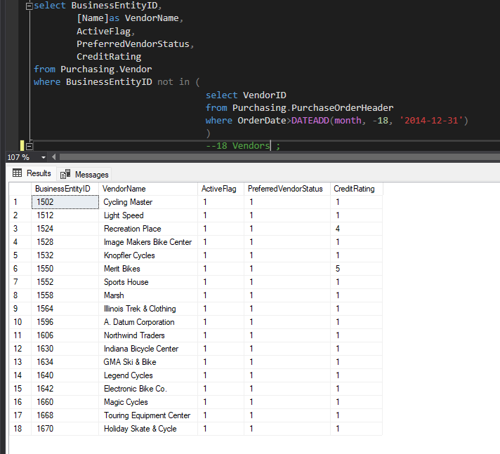
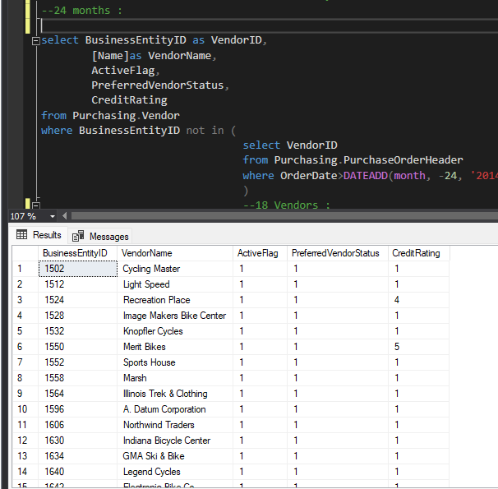
Test the basic variables
Checking if there are vendors who haven’t received orders for 18 and 24 months.
OBS: 18 Vendors.
Notes:
Links:
https://www.pexels.com/photo/men-s-wearing-black-suit-jacket-and-pants-937481/
https://www.pexels.com/photo/business-businessman-contemporary-corporate-532220/
https://www.pexels.com/photo/happy-ethnic-woman-sitting-at-table-with-laptop-3769021/
https://www.pexels.com/photo/cheerful-woman-smiling-while-sitting-at-table-with-laptop-4467687/

Slide 7
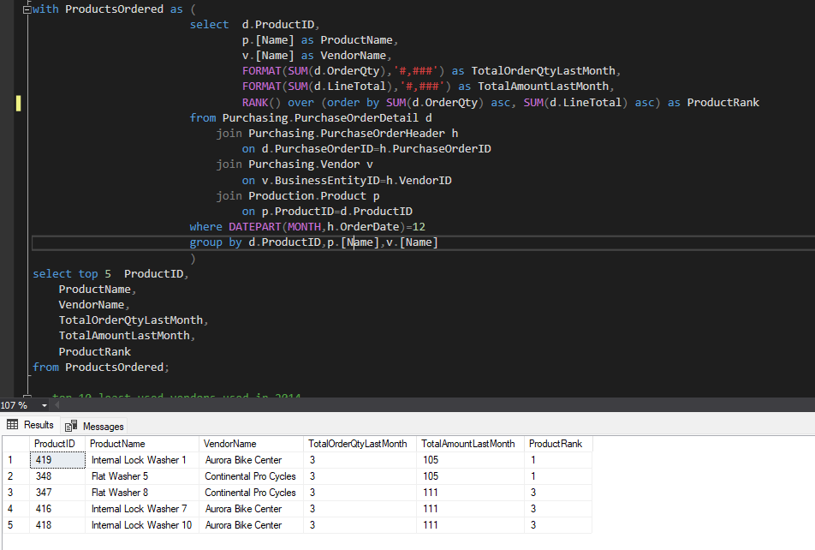
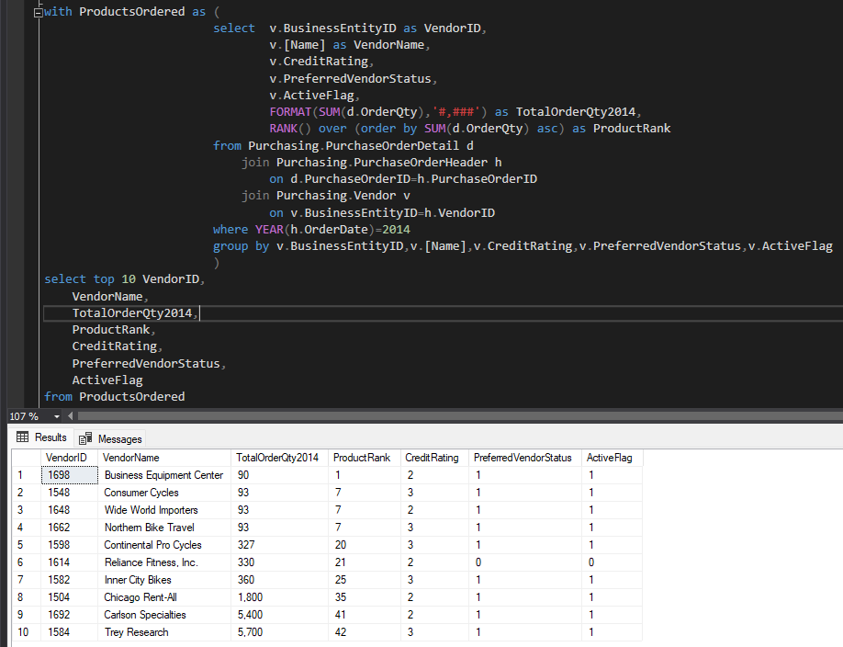
Test the basic variables
Top 5 least ordered products in last the Month of 2014
Top 10 vendors with the least sales in 2014
Notes:
Links:
https://www.pexels.com/photo/men-s-wearing-black-suit-jacket-and-pants-937481/
https://www.pexels.com/photo/business-businessman-contemporary-corporate-532220/
https://www.pexels.com/photo/happy-ethnic-woman-sitting-at-table-with-laptop-3769021/
https://www.pexels.com/photo/cheerful-woman-smiling-while-sitting-at-table-with-laptop-4467687/

Slide 8
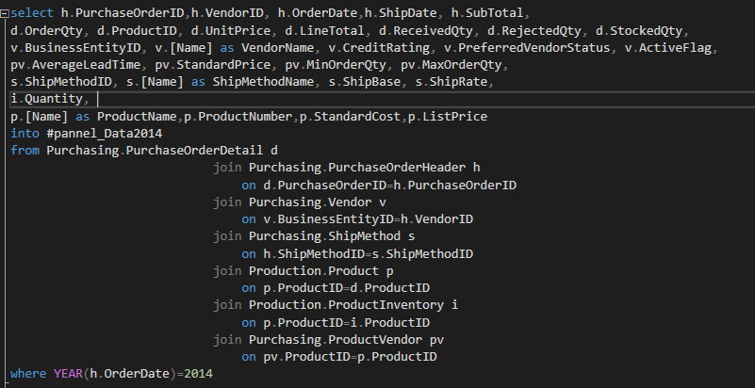
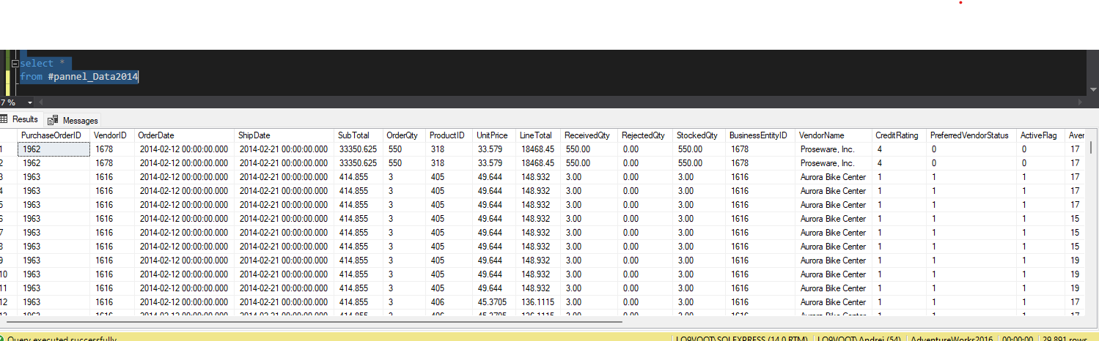
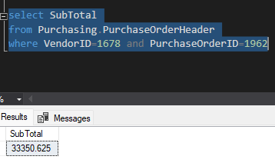
Write the code including documentation tests and controls
TEST
Notes:
Links:
https://www.pexels.com/photo/men-s-wearing-black-suit-jacket-and-pants-937481/
https://www.pexels.com/photo/business-businessman-contemporary-corporate-532220/
https://www.pexels.com/photo/happy-ethnic-woman-sitting-at-table-with-laptop-3769021/
https://www.pexels.com/photo/cheerful-woman-smiling-while-sitting-at-table-with-laptop-4467687/

Slide 9
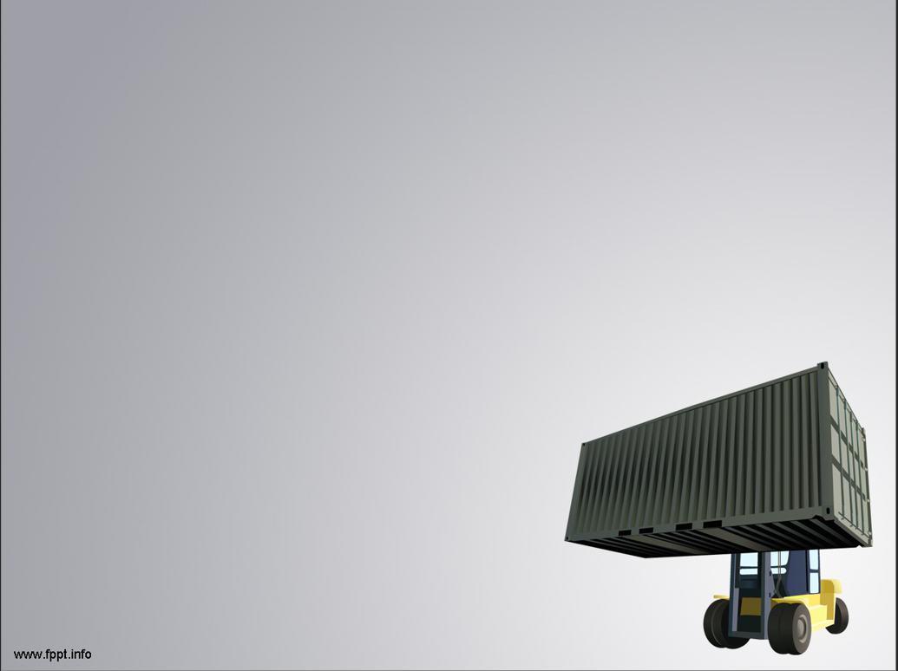
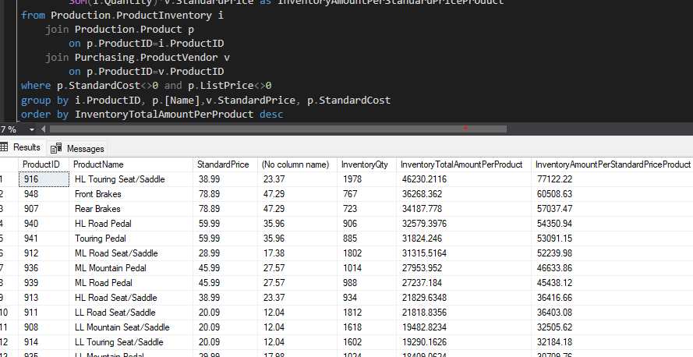
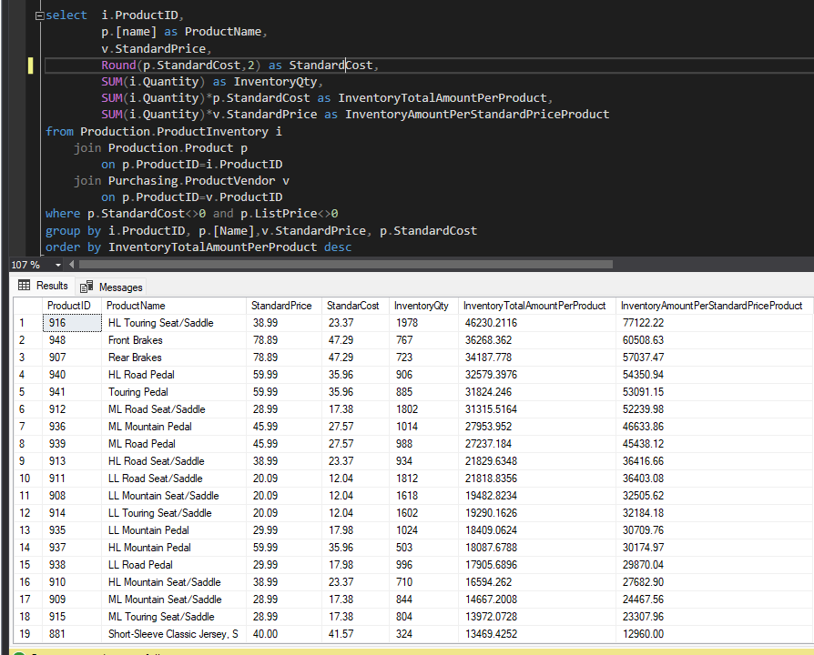
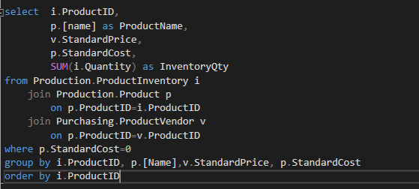
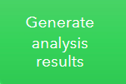
List of Products in Stock for Inventory
Question: Why there are 338 Products that have the Standard Cost 0?

Slide 10
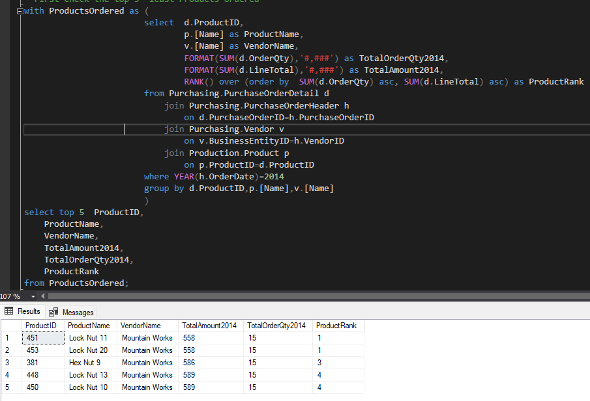
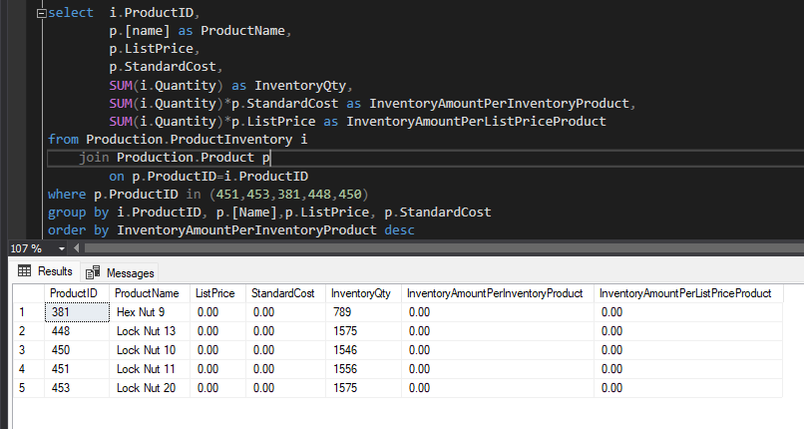
Things to do to improve the inventory
1)Check the top 5 least Products Ordered
2)We compared the results with the Inventory List
Question: Why the Standard Cost and List Price are 0?
We can see that even though we have a significant stock in Inventory List, the Standard Cost, List Price, Inventory Amount Per Inventory Product and Inventory Amount Per List Price Product are 0
Recommendations:
- A Marketing campaign, promotion to sell those products so we can clear the inventory stock
- Inform the Procurement Department that those products are no longer available to order
Notes:
Links:
https://www.pexels.com/photo/men-s-wearing-black-suit-jacket-and-pants-937481/
https://www.pexels.com/photo/business-businessman-contemporary-corporate-532220/
https://www.pexels.com/photo/happy-ethnic-woman-sitting-at-table-with-laptop-3769021/
https://www.pexels.com/photo/cheerful-woman-smiling-while-sitting-at-table-with-laptop-4467687/

Slide 11
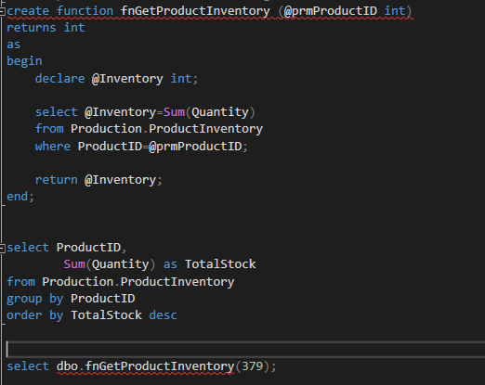
fnGetProductInventory Function - This function provides the current stock for a specific product.
(It could be a tool for the daily activity for the inventory manager)

Slide 12
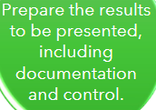
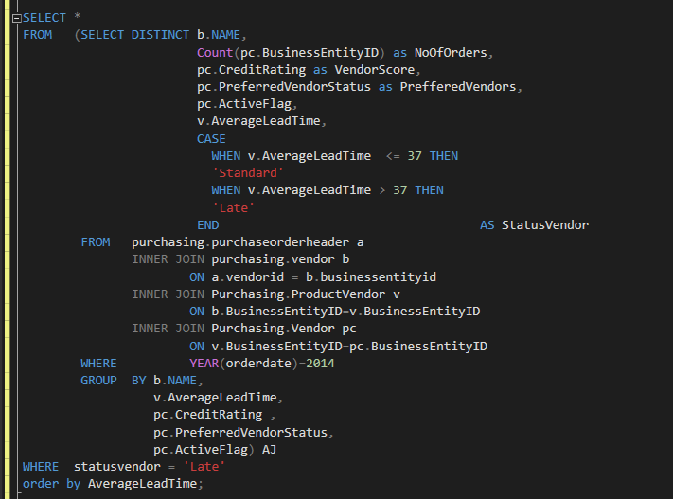
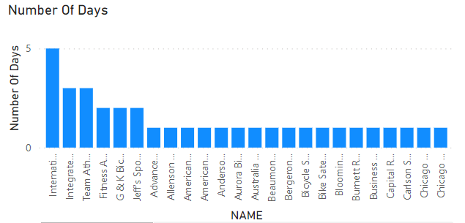
Vendors who experiencing delays with their orders.
OBSERVATIONS: Out of 86 vendors, 78 estimated a delivery time of 35 days. 8 of these vendors offer a minimum term of 45 days, which is too long from our perspective.
RECOMMENDATION: Inform the necessary departments to engage with the 7 vendors and change/optimize the delivery procedure to achieve a reduced delivery time.
RECOMMENDATION: Modify performance ratings
Notes:
Links:
https://www.pexels.com/photo/assorted-color-trailer-boxes-2881632/

Slide 13
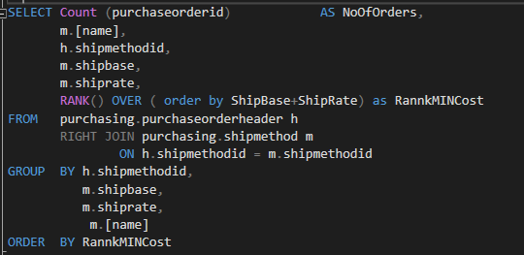
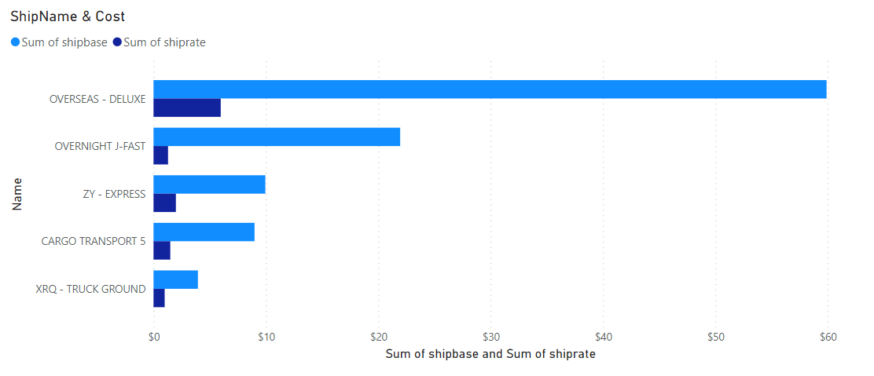
1.ShipMethod 3 is the only one experiencing delays, and it also has the highest costs both in ShipBase and in ShipRate.
We recommend using ShipMethod 3 only in urgent cases when we have exhausted the other four options.
2.The majority of orders are made using ShipMethod 4 and 5, BUT the costs of Ship-Method 1 are much more advantageous/cheaper.
We recommend reviewing the policy to collaborate more with ShipMethod 1 in the future to reduce costs.
Notes:
Links:
https://www.pexels.com/photo/men-s-wearing-black-suit-jacket-and-pants-937481/
https://www.pexels.com/photo/business-businessman-contemporary-corporate-532220/
https://www.pexels.com/photo/happy-ethnic-woman-sitting-at-table-with-laptop-3769021/
https://www.pexels.com/photo/cheerful-woman-smiling-while-sitting-at-table-with-laptop-4467687/

Slide 14
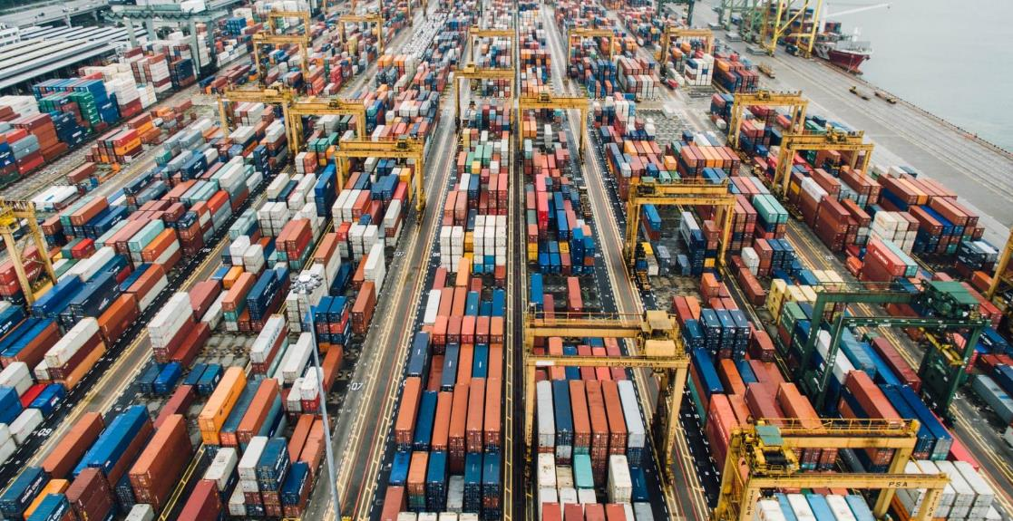
Conclusion
Recommendations
-A close monitoring of these vendors, checking if possibly there is another supplier for their products and modifying their scorecard.
-We should ask further and deep dive to find out why there are so many products with the Standard cost 0.
-We recommend using Ship Method 3 only in urgent cases when we have exhausted the other four options.
-We recommend reviewing the policy to collaborate more with Ship Method 1 in the future to reduce costs.
-There are 18 vendors that did not have any orders in the last 24 moths;
-We observed that there are 338 products that have the Standard cost 0.
-Ship Method 3 is the only one experiencing delays, and it also has the highest costs both in Ship Base and in Ship Rate.
-The majority of orders are made using Ship Method 4 and 5, BUT the costs of Ship-Method 1 are much more advantageous/cheaper.
Notes:
Links:
https://unsplash.com/photos/fN603qcEA7g

Slide 15
Thank You!
Notes:
Links:
https://www.pexels.com/photo/black-sail-ship-on-body-of-water-906982/

